Slide 1
OECD:
BETTER (COMPETITION) POLICIES FOR BETTER LIVES
Ania Thiemann, Global Relations Manager,
Competition Division, OECD

Slide 2
OECD Better policies/lives from every angle
Fairer
Development
assistance
Migration
Education
Healthcare
Pensions
Employment
Competition
Corruption
Trade
Governance
Tax
evasion
Entrepreneurship
Fiscal policy
Climate
change
Stronger
Innovation
Cleaner
Finance
Agriculture
Energy
Notes:
OECD’s vision is a stronger, cleaner, fairer world
OECD takes an economic approach to everything
Areas to highlight include:
Development assistance
Education/PISA
Gender
New sources of growth

Slide 3
Outreach Programme
Assist both Members and non-members to improve their competition laws and policies; support countries worldwide to attain the OECD’s international best practices.
Work closely with key emerging and transition economies, assisting with drafting competition laws, building their enforcement capacities and promoting pro-competitive regulatory reforms.
Hold an annual Global Forum on Competition (GFC) which provides an opportunity for policy dialogue and networking.
Hold an annual Latin American Competition Forum , promoting dialogue, consensus building and networking.
Ongoing work through the OECD's regional centres on competition in Budapest and Seoul, which provide regional hubs for the training of competition enforcement officials.

Slide 4
GFC - Global Forum on Competition
Who participate?
GFC = major events, attracting approx. 400-500 participants from 100+ countries, engage Member and non-member countries
GFC is inter-governmental: mainly competition authorities and relevant ministry representatives
Regional and international organizations (e.g. COMESA, IDB, WAEMU, World Bank Group, UNCTAD, and WTO) also participate
Through BIAC, TUAC and Consumers International, representatives of the business community and consumers also have an input
International experts, researchers and various other stakeholders can be invited to nourish the dialogue
Meetings under the aegis of the OECD Competition Committee
Notes:
An important global platform and efficient mechanism to treat global competition issues, to foster peer learning and worldwide competition policy dialogue:
Broad focus on development: promotes a wider dialogue and linkage between competition policy and other cornerstones of economic development: e.g. corruption, growth, poverty.
Benefits from the input of the Competition Committee whose work has already generated substantial results in many countries:
→ Voluntary adoption of best practices, substantial analytical convergence, strong networks of enforcement authorities, enhanced co-operation.

Slide 5
Global Forum on Competition (cont’d)
2014 TOPICS
Fighting corruption and promoting competition
Competition issues in the distribution of pharmaceuticals
Review of Romania’s competition law and policy
2015 TOPICS
Does competition kill or create jobs? Links and drivers between competition and employment
Sectors that attract endemic collusion
Review of Kazakhstan’s competition law and policy
Enforcement in the presence of disruptive innovations
More info: http://www.oecd.org/competition/globalforum/

Slide 6
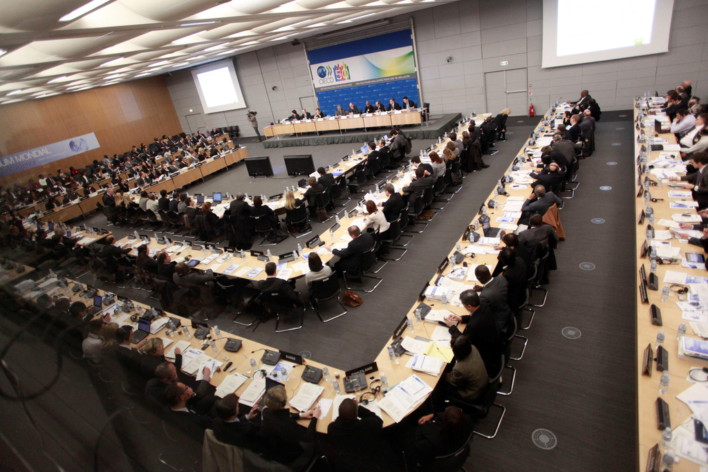
Global Forum on Competition (cont’d)

Slide 7
LACF – Latin American Competition Forum
FOUNDATION
Launched in April 2003 by the Inter-American Development Bank (IDB) and the OECD as a joint effort to foster effective competition law and policy in Latin America and the Caribbean.
Who participate?
Senior officials of Latin American and Caribbean competition institutions. Participants in previous LACF meetings include:
Competition experts from OECD countries
Regional and international organisations (CARICOM, ECLAC, UNCTAD, the World Bank and WTO).
OECD Secretariat
Notes:
RATIONALE
Regionally-focused activities are a necessary complement to the OECD Global Forums, attracting smaller and more homogeneous constituencies
Sharper focus on region-specific issues and the monitoring and implementation of the principles dealt with by the forums
LACF is concrete means for IDB and OECD to promote dialogue, consensus building and networking among policy makers and enforcers in the region
MISSION
Meeting once a year in a Latin American country with the partnership/support of a host competition authority.
Promote dialogue, experience sharing, consensus building and networking between competition policymakers, sector regulators and law enforcers; emphasis en experience sharing
Identify and disseminate best practices in competition law and policy in a collegial setting; regional relays in implementing OECD’s policies and practices.

Slide 8
Latin American Competition Forum (cont’d)
2014 TOPICS (Uruguay):
Electricity markets in Latin America: Regional integration and competition issues
Peer review of Costa Rica's competition law and policy
Advocacy: Mainstreaming competition policy into the overall economic policy and government actions
2015 TOPICS: 23 and 24 September, 2015, Jamaica
Competition in the groceries retail sector (supermarkets) in Latin America and the Caribbean
Advocacy: agency effectiveness and impact assessment
More info: http://www.oecd.org/competition/latinamerica/

Slide 9
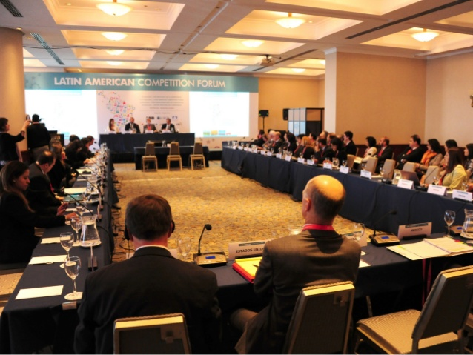
Latin American Competition Forum 2014

Slide 10
Regional competition policy centres
  FOUNDATION
  Two regional centres for competition law & policy:
    Korea (KPC): joint venture OECD - Korean government
    Hungary (GVH): joint venture OECD – Hungarian competition authority
  MISSION
  Effective hub for officials to exchange knowledge and experiences
  Capacity building in competition law and policy on regional basis
  Sharing of OECD best practices at regional level, incl. non members
  Help develop and implement effective competition law and policy
  Facilitate regional co-operation

Slide 11
Capacity building: tailor-made to individual needs
  On the Menu:
  Technical assistance with reviewing of legal frameworks; contribution to advocacy efforts; assessment of market studies; impact assessment of regulation; ex-post evaluation; fighting bid-rigging; public procurement guidelines; secondments; workshops and seminars….
Workshops and seminars designed for the needs of individual competition agencies and bodies:
  CCI: competition assessment (Oct 2014) and leniency: practical application (June 2015)
  ACF: bid-rigging (Tunisia, June 2014)
  South Africa: Series of workshops on competition assessment and support with advocacy for the use of competition assessment (July 2015 and November 2015)
  Jamaica: seminar on competition assessment and impact assessment (September 2015)
Regional programmes:
  Market studies assessment and guidelines for 6 Latin American countries (finalised March 2015)
Notes:
In-country assistance provide competition agencies and policy makers with tools and techniques reflecting international best practices and analytical discussions among the world's leading competition enforcers on the latest policy developments.

Slide 12

Targeted reviews
Review by OECD of selected aspects of a country’s competition regime
  Mexico projects since 2007
  Chile: Report of Merger Control
  Identification of key issues
  Assessment under int’l standards
  Tailored to country’s legal, eco, institutional reality
  Recommendations for improvement
  Cooperation with government on new merger law
  More info:
  http://www.oecd.org/daf/competition/chile-merger-control-2014.htm
Notes:
Focus on e.g.:
A specific area competition law enforcement: merger control, cartels, abuses
Enforcement procedures and powers
Institutional design
Impact on consumers of competition enforcement and interventions
Mexico Competition Project:
Since 2007: “Process for the Strengthening of Competitiveness in Mexico”
Two pillars:
supporting pro-competition reforms
supporting regulatory improvement
Creation of a Competition Technical Group: examine laws and regulations in priority sectors
Includes experts from: Mexico’s competition authority, OECD and outside experts, under supervision of OECD Competition Division
Relies e.g. on the OECD Competition Assessment Toolkit and Guidelines for Fighting Bid Rigging in Public Procurement (see infra).

Slide 13
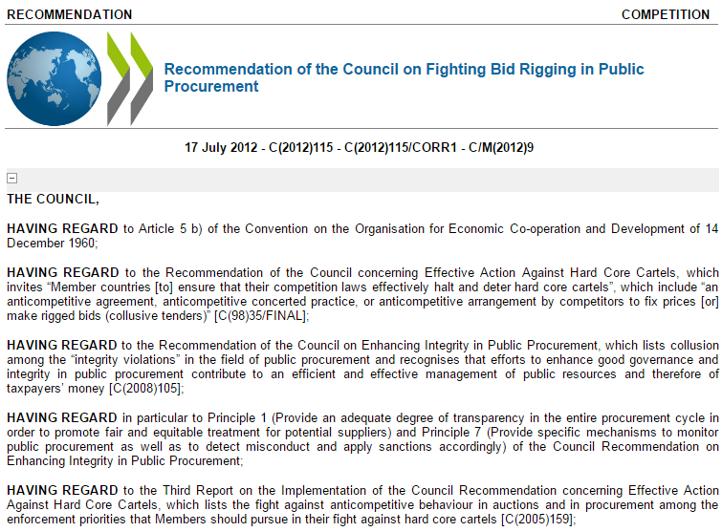

Fighting bid rigging
OECD Council Recommendation (2012) and Guidelines (2009) on Fighting Bid Rigging in Public Procurement
http://www.oecd.org/daf/competition/fightingbidrigginginpublicprocurement.htm
Notes:
OECD Recommendation and Guidelines goal:
To promote more effective and competitive procurement and
reduce risk of bid rigging in public tenders
1. Assessment:
Call for governments to assess their public procurement laws and practices at all levels of government
2. Capacity building:
OECD trainings around the world:
How public procurement officials can prevent, detect and address bid rigging
From targeted trainings to extensive review of public procurement regime
Already trained thousands of officials from a variety of jurisdictions + on-going projects: e.g. Colombia, Italy, Malaysia, Mexico, Panama, Poland, Romania, South Africa
Requires specific request and funding from the interested country

Slide 14
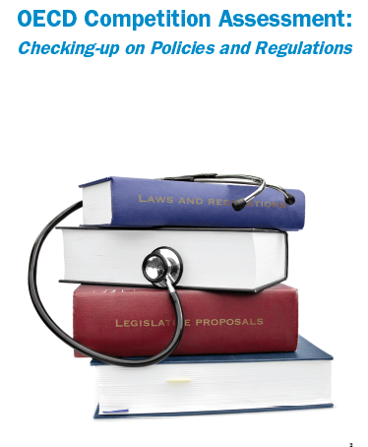
Competition Assessment Toolkit
Tools for the diagnostic of regulatory impact on competition
Competition law and enforcement: usually directed at business companies’ practices
≠ Toolkit: directed at governments’ regulations and regulatory interventions
Competition policy review: often focuses on effectiveness of competition law and enforcement
≠ Toolkit: focuses on sector regulations, how they impact competition
More info: http://www.oecd.org/competition/assessment-toolkit.htm

Slide 15
THANK YOU

