Slide 1
Agency ethics
– How to ensure awareness and compliance?
Kjell Jostein Sunnevåg
The Norwegian Competition Authority

Slide 2
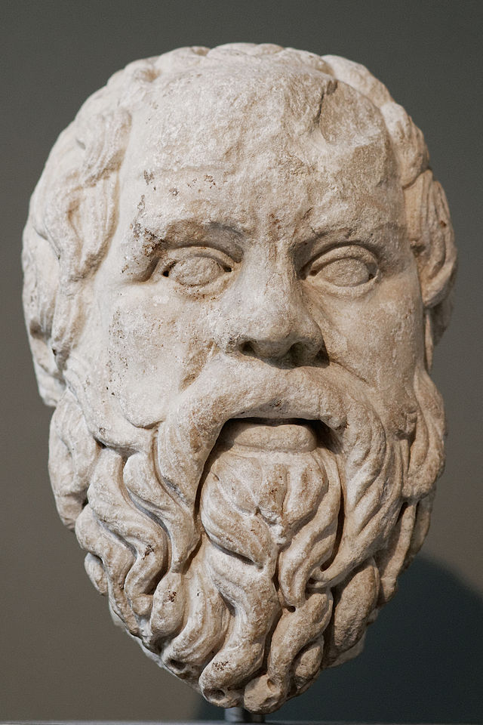
Ethics and integrity
The formal framework
  General ethical guidelines
  Specific ethical guidelines for the Norwegian Competition Authority
What we do to enhance awareness and compliance
  Material presented to new employees
  Training on ethical dilemmas
  Create a culture for compliance and
  awareness
  A “Crisis” strategy if violations occur
Ethical dilemmas

Slide 3
The importance of ethics and integrity in enforcement
High ethical standards in the provision of public services and the exercise of authority are a prerequisite for
  Trust in the service by the parties, the general public and the politicians
  Accountability
  … and not the least: Efficient enforcement and deterrence
Two sets of guidelines (in addition to other laws and regulations applicable to public servants):
  General Ethical Guidelines for the Public Service
  Ethical Guidelines for the Norwegian Competition Authority (NCA)
The goal of the general and the NCA specific ethical guidelines is to ensure that all State employees are aware of the fundamental importance of high ethical standards
Notes:
Norway has many rules of law (statutory and non-statutory) that impact values and ethics in the public service, eg. Public Administration Act, Securities Trading Act; Act relating to civil servants (Forvaltningsloven, tjenestemannsloven og verdipapirhandelloven)… inneholder blant annet regler om taushetsplikt, habilitet, adgangen til å motta gaver og handel med verdipapirer. Personnel Handbook for State Employees contains information on ethical guidelines that apply to all employees and refers to the ethical guidelines.

Slide 4
General Ethical Guidelines for the Public Service
The ethical guidelines have evolved from ethical values and norms of universal validity such as
  justice, loyalty, honesty, reliability, truthfulness and “treat others like you want to be treated”
The State ethical guidelines are of a general nature, rather than providing detailed rules
  Intended to call for reflection on the part of the individual employee

Slide 5
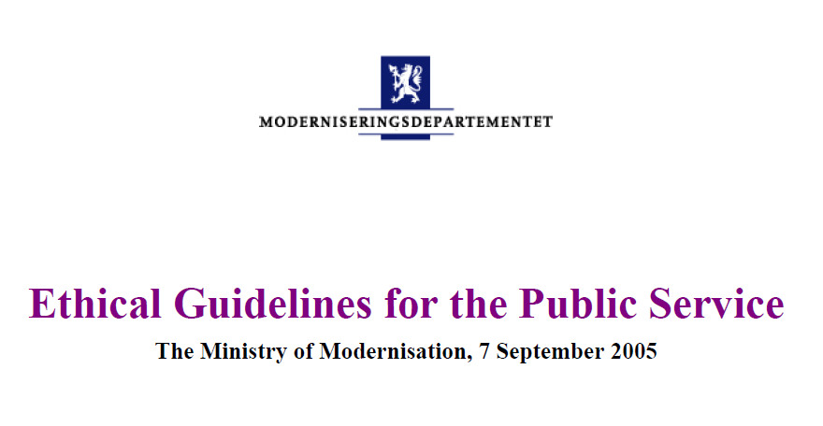
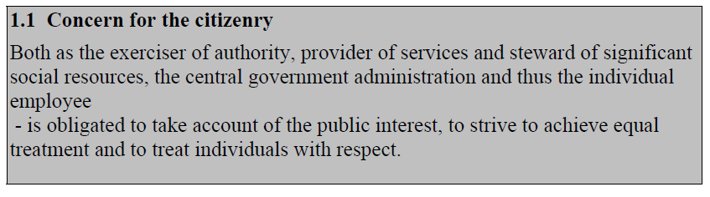
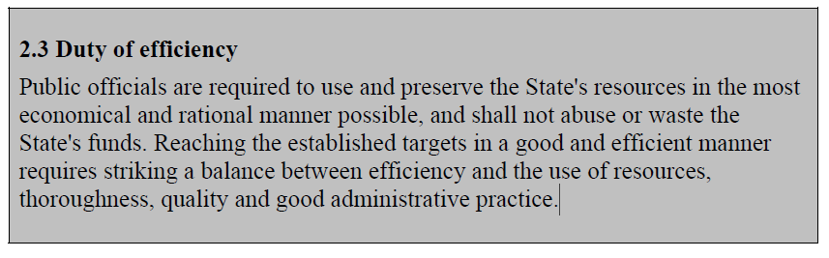
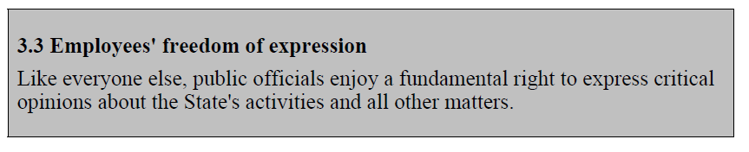
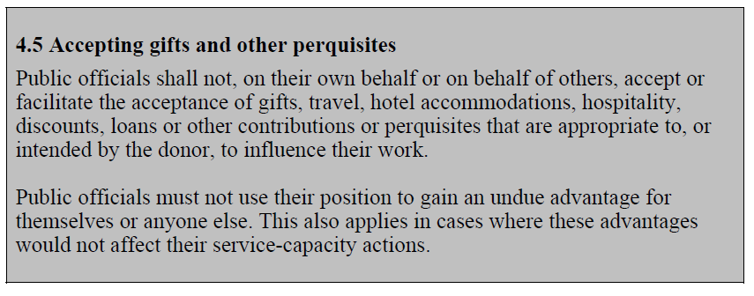
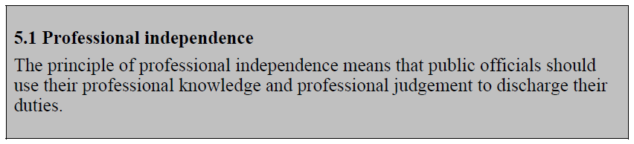
General Ethical Guidelines for the Public Service
General provisions
Loyalty
Transparency
Confidence in the
public service
Professional
independence
and objectivity

Slide 6
Ethical Guidelines for the Authority
The main rule:
  Contribute to preserve confidence in the Authority and its reputation
Loyalty
Neutrality/impartiality
Obligation to observe professional secrecy
Professional neutrality
Observe rules relating to trade with securities
Outside and extra jobs within regulations
Personal integrity and behaviour
Notes:
«The Authority’s ethical guidelines» describe more specifically and supplement crucial parts of the the more general ethical rules and guidelines.
Through agency specific guidelines, we make them more relevant and accessible for the employees; which contribute to a common stance among the emplyees.

Slide 7
How to ensure compliance and awareness?
- Training and group discussions on ethical dilemmas
Some acts imply a clear violation of ethical guidelines … as well as other laws which apply to civil servants
However, not all cases are clear cut
  Discussing ethical dilemmas in internal workshops creates «ethical awareness»

Slide 8


How to ensure compliance and awareness?
- Training and group discussions on ethical dilemmas
You discover that a «a sloppy collegue» has accidentily leaked business secrets to a competitor in a merger case
  What do you do?
During a dinner with friends, a «friend of a friend» talks too much and reveals he’s involved in activity violating competition law
  What do you do?

Slide 9


How to ensure compliance and awareness?
- Training and group discussions on ethical dilemmas
Insider information and personal relations:
You get information from a colleague implying that securities owned by your wife
will be reduced significantly in value
  What do you do?
You meet a former colleague in a meeting relating to a competition case. Now he’s on the other side of the table. He uses information acquired in his former position to the authority’s disadvantage and to impress his client
  What do you do?
  Which measures can the authority take to prevent this?

Slide 10
Reflections on how to ensure compliance and awareness?
  Establish and reassess guidelines and routines
Have information material on ethical guidelines easily available
  «Information package» to new employees
  Information must be easily accessible on eg. intranet website
Periodic internal training on ethical dilemmas. This:
  …raise ethical awareness through reflections on specific and relevant dilemmas
  …create awareness of guidelines
Create culture for openness and trust on ethical issues
    Nurture a «culture of compliance and awareness»
Even if all precautions are taken - «Shit happens»: A ‘Crisis’ strategy is recemmended:
  External communciation
  Internal communciation
  HR strategy with measures for care and/or consequences
  Management crisis training – Play out possible crisis situations
Notes:
Formal rules on insider information: Insider list?

