Slide 1
FEDERAL ANTIMONOPOLY SERVICE
OF THE RUSSIAN FEDERATION
Effective recruitment process
in the FAS Russia
Ruslan Makhmudov,
Senior expert of the FAS Russia
Gaborone, 2016
Notes:
Навыки председательствующего позволяют быстро достичь высокой эффективности при работе с группами людей. Роль председателя заключается в разработке повестки дня, обеспечении участия людей в мероприятии и управлении темпом его проведения. Воспользуйтесь данными стратегиями Dale Carnegie Training® для успешного проведения совещания.
Рекомендуется предоставить раздаточные материалы, чтобы сфокусировать обсуждение на важных моментах и дать возможность присутствующим записать свои идеи. При печати раздаточных материалов в режиме трех слайдов на страницу PowerPoint автоматически включает пустые строки для заметок участников.

Slide 2

About the FAS Russia
There are several reasons why the staff selection process is important in the activity of the FAS Russia:
More than 3500 employees are working in the FAS Russia:
  1189 employees in the Central Office of the FAS Russia;
  2315 employees in 85 Regional Offices of the FAS Russia.
The average age of employees of the FAS Russia – 27-35 years old.
All employees of the FAS Russia have a high education degrees in law, economy and etc.
Many employees of the FAS Russia have a PhD degree.

Slide 3

The process of the selection of the professional staff
The recruitment procedure and conditions for the civil service in the FAS Russia are based on the general principles of the legislation on the state civil service and are exercised in accordance with the Federal Law “On State Civil Service of the Russian Federation”;
The qualifying requirements are established by the Decree of President of the Russian Federation “On Qualifying Requirements to the Experience of the State Civil Service (state service of other types) or Length of Professional Work for Federal State Civil Servants”.
3

Slide 4

The process of the selection of the professional staff
  In accordance with the legislation the staff selection is carried out on a competitive basis (the recruitment procedure is assessing the professional level of candidates and their compliance with recruitment qualifications).
  Information about job vacancies, dates and condition of the recruitment procedure for a vacant position of the state civil service are published on the official website of the FAS Russia (URL: http://fas.gov.ru/about/civil-service/competitions/).
4

Slide 5

The process of the selection of the professional staff
Selection Board of the FAS Russia performs the recruitment procedure aimed at filling of vacant positions.
The Selection Board consists of internal staff of the FAS Russia and external experts.
The structure of the Selection Board prevents the possibility of conflicts of interests which could affect decisions made by the Selection Board.
The Selection Board is in charge for assessing of the professional level of the candidates for the vacant position and their compliance with recruited qualifications.
5

Slide 6

The process of the selection of the professional staff
Major qualification requirements common to all categories and groups of positions:
requirements to the level of professional education;
field of study;
professional knowledge and skills;
experience in the field of state civil service or relevant professional experience.

Slide 7

Mentoring program for the new employees
For the employees recruited to the FAS Russia is set a probationary period from 3 months to 1 year.
A mentor is officially assigned for a new employee during the probationary period.
The task of a mentor is to provide an employee with new experience and knowledge necessary for work, to help an employee in joining the team and to perform all organizational and human activities that are required for each new employee of the FAS Russia.

Slide 8

Education and training courses
There are a special training courses for beginners who came to the civil service to the FAS Russia for the first time.
In order to develop their knowledge, the employees attend seminars and other training courses, social and team building events.
Annually the FAS Russia elaborates and approves the Plan of regional workshops and training events. The emphasis on educational events is placed on increase of skills and professional knowledge of staff of the FAS Russia’s Regional Offices in the application of the legislation and interaction with other authorities, including courts.
8

Slide 9
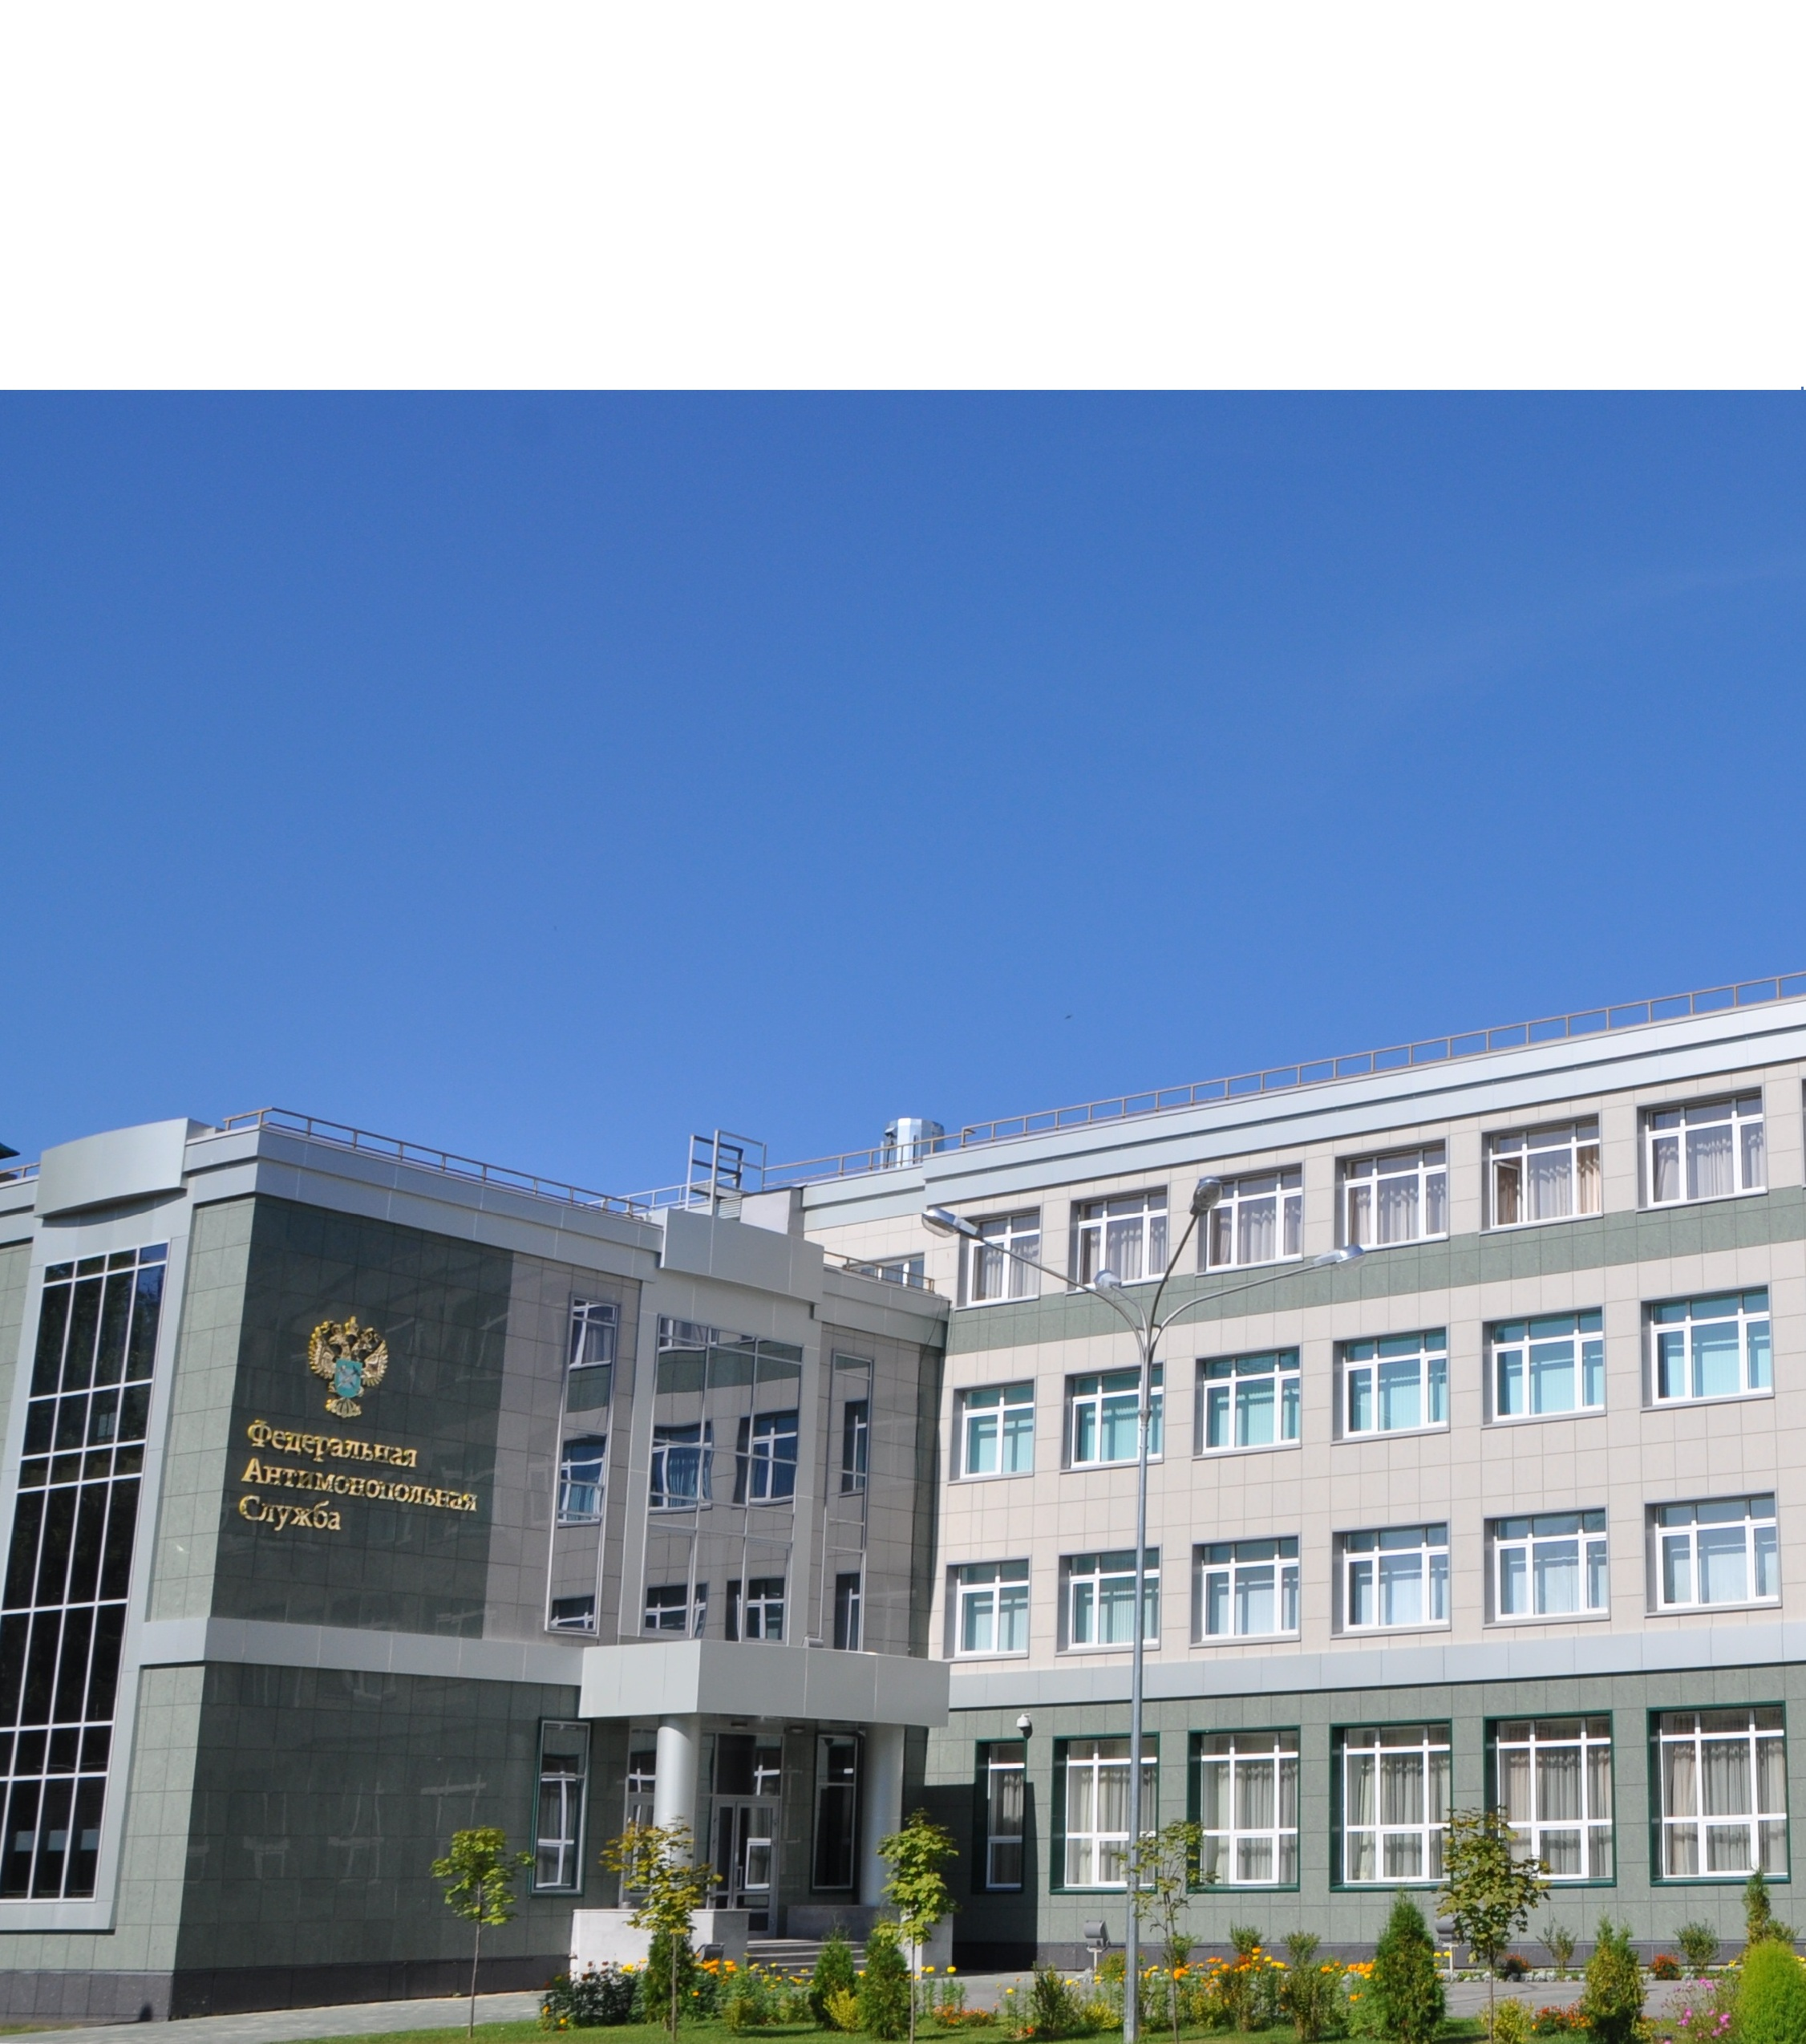
Training and Resource Center of the FAS Russia
The FAS Russia has the Training and Resource Center in the city of Kazan (URL: http://emc.fas.gov.ru).
Center features:
provision of training and professional retraining of experts of the Federal Antimonopoly Service and its Regional Offices, civil servants of Competition Authorities of EAEU, CIS countries;
development of scientific studies and research projects on contemporary issues of competition regulation and launching of discussing it within the academic community;
spreading of international best practices in the field of antitrust regulation, as well as organizing and carrying out of joint projects on scientific and practical research, conferences, seminars and other events with foreign Competition Authorities.

Slide 10
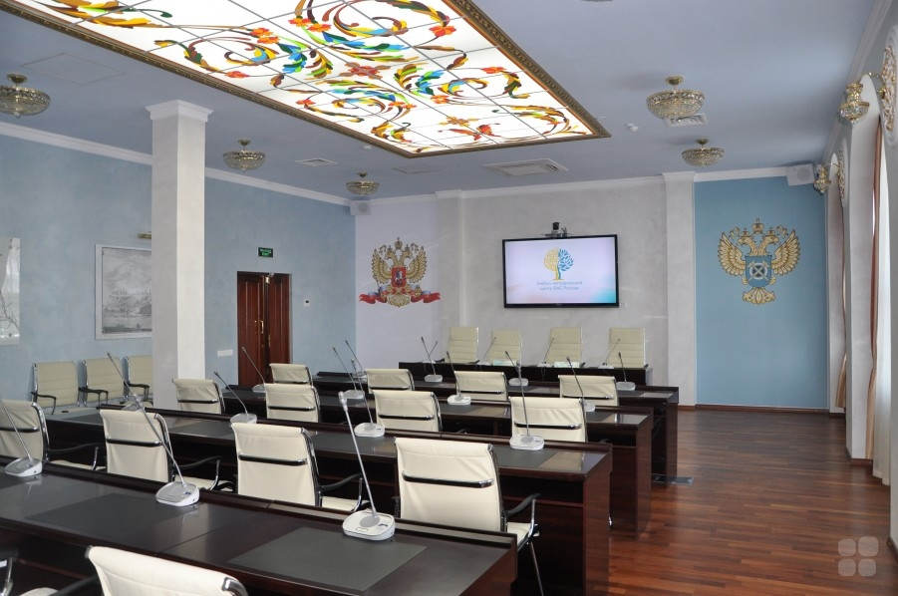
Training and Resource Center of the FAS Russia
Center facilities:
The Center has necessary infrastructure required for accommodation and study of employees:
Classrooms;
Conference halls;
Learning resource center (e-library);
Hotel for trinees;
Coffee-houses and restaurants;
and etc.

Slide 11

Perspective personnel reserve
The perspective Personnel reserve is formed in order to prepare the Senior officials, who meet the following Authority goals:
a) Personnel reserve for the position of the “Head of the Regional Office” - 80 persons;
b) Personnel reserve of the Central Office of the FAS Russia - 25 persons.
Members of the perspective Personnel reserve may receive additional tasks directly from the Head of the FAS Russia.

Slide 12
Perspective personnel reserve
Each perspective personnel reservist annually elaborates and executes the personal development plan, which includes:
contribution to the solution of strategic tasks of the FAS Russia’s departments and/or the FAS Russia in general;
tasks for elaboration of administrative, organizational and analytical skills;
activities connected with the chosen specialization;
acquisition of new professional skills and technologies;
possibilities for legal training;
general training (improvement of the educational skills, etc.).
Regular meetings of perspective personnel reserve with the Head of the FAS Russia stimulates employees for increasing the efficiency of their work.
The assessment of the results on the execution of orders by the perspective Personnel reservist is held by the experts both from Central and Regional Offices of the FAS Russia.

Slide 13

The project “My useful initiative”
The main goals of the Project:
development of professional competence of the Service’s employees;
development of management skills and motivation of personnel;
keeping the right people and formation of the current personnel reserve;
creation of bank of ideas and initiatives.
As an award for the best initiative, the winner is rewarded by an internship to the foreign competition authority and his/her initiative is assessed by the senior management and may be implemented to the Service’s practice.

Slide 14

Rotation and career development
Rotation of civil servants of the FAS Russia is exercised in accordance with the legislation of the Russian Federation and allows:
  to promote the career development of civil servants;
  to evaluate the results of the professional activity of civil servants;
  to apply modern recruitment technologies during the civil service of employment.
For example: as part of the rotation scheme eight managing employees for the Regional Offices of the FAS Russia were appointed in 2014.
PhD decree helps the civil servants in career development.

Slide 15
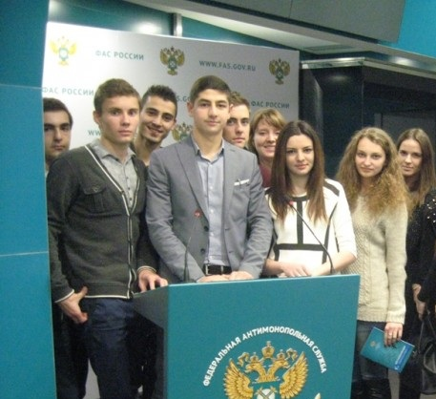
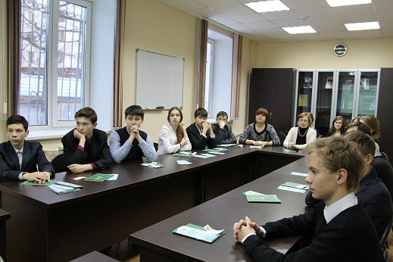
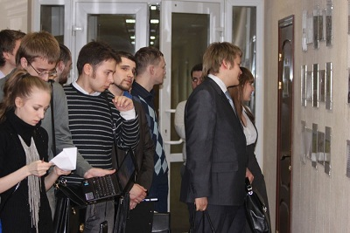
Formation and maintenance of interest to the FAS Russia’s activity
“The Federal Antimonopoly Service is always open for young professionals” - under this slogan is annually held the “Day of Open Doors” for schoolchildren and students from the Russian leading Universities.
The FAS Russia creates conditions for practical training of students who wants to find out more about the Service activities.
The FAS Russia actively cooperates with leading Universities of the Russian Federation. At many faculties the Chairs of competition law and economics were opened where employees of the FAS Russia are lectures.
Openness is one of the key principles of activity of the FAS Russia. In this regard all information about the Service activity post on the Authority’s website (URL: http://fas.gov.ru/http://en.fas.gov.ru) and other websites (Facebook, Twitter, etc.).

Slide 16






THANK YOU FOR ATTENTION!
en.fas.gov.ru
emc.fas.gov.ru
FAS-book
@rus_fas & @fas_rf (eng)
fasovka
international@fas.gov.ru
16

Slide 17



www.ccs.gov.sg

Slide 18
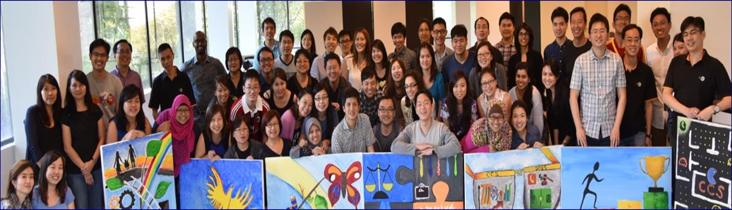
CCS’s ORGANISATIONAL PROFILE
CCS Staff Profile by Job Category [as of 29 Feb 2016] | No. | %
Specialist staff involved in Case work, Advisories and Market Studies | 32 | 51%
Generalist staff e.g. HR, Finance, IT and Strategic Planning | 24 | 38%
CCS Senior Management | 7 | 11%
TOTAL: | 63 | 100%

Slide 19
STAFF ISSUES
Two Categories:
                Performance
                Health
Two Approaches:
        Prevention (P)
        Cure (C)

Slide 20


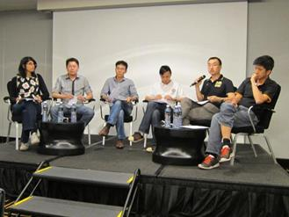
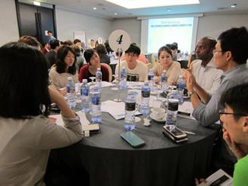
STAFF ISSUES – PERFORMANCE (P)
Robust Selection Processes
Written test to assess candidate’s technical competency and writing skills
Interviews conducted by Chief Executive and Directors
Clear Staff Development Plan
Competency framework for various types of job
Total learning plan – contains all learning opportunities available to staff

Slide 21
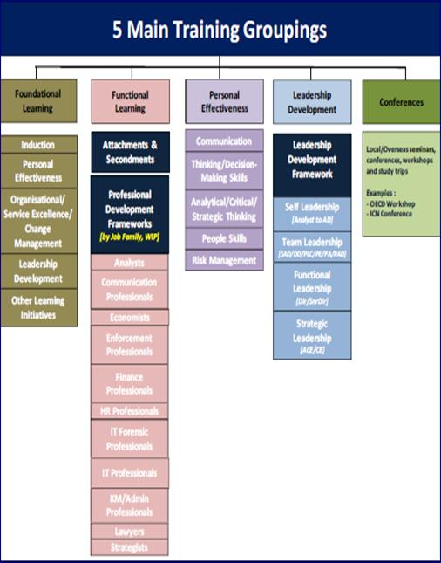
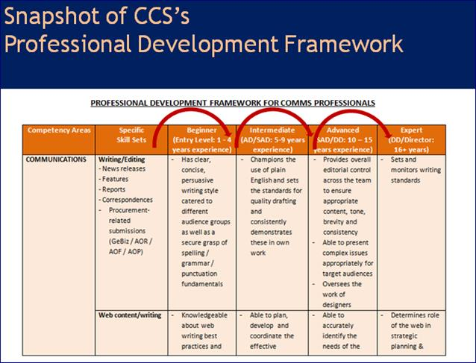
STAFF ISSUES – PERFORMANCE (P)
Total Learning Plan and Professional Development Frameworks

Slide 22
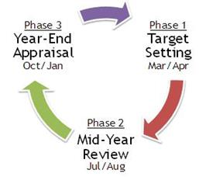

STAFF ISSUES – PERFORMANCE (C)
Timely Feedback Processes
2 appraisals per year
Includes case team feedback
Identify performance gap and training needs
Under Performance Cases
For new staff, 1 year probation with the option to extend by another 6 months
For confirmed staff, it will be 3+3 months of Performance Review Process (“PRP”)

Slide 23

STAFF ISSUES – PERFORMANCE (C)
Under Performance Cases
Coaching
Identify specific areas of improvement
Set clear work targets; and
Explicit about the period of assessment.
These will be documented and used for the purpose of reviewing the officer’s performance at the end of the assessment period.

Slide 24

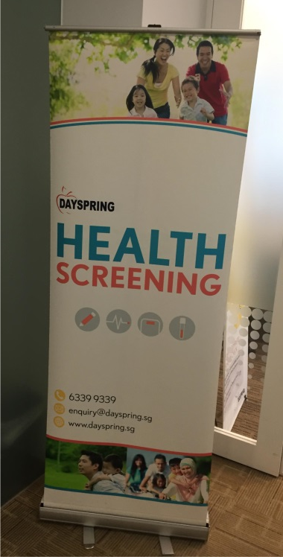

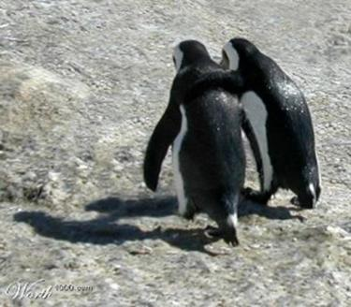

STAFF ISSUES – HEALTH (P)
Medical Check-Up
Pre-employment medical check-up
Annual health screening
Support Structure
Telecommuting
Staggered work arrangement
Buddy system
Mentoring
Open door policy

Slide 25
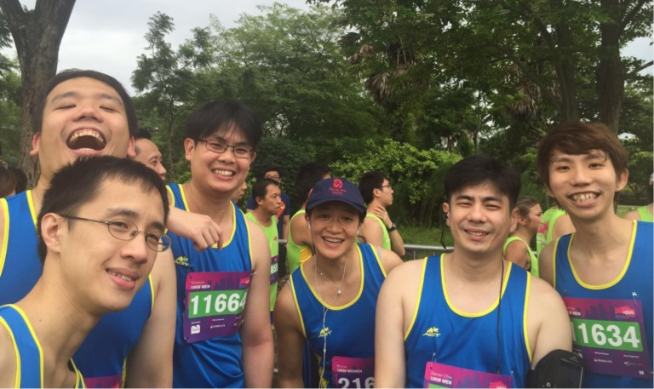
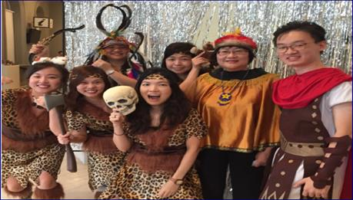
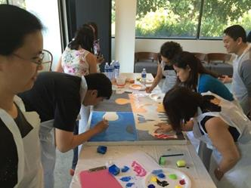
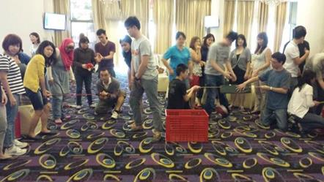
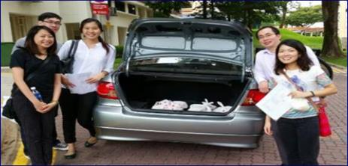
STAFF ISSUES – HEALTH (P)
2016 Marina Run
Welfare Activities
“Sports” Wednesday
Teambuilding exercises
Recreation club activities, including CSR
2015 CCS Dinner & Dance
Team Building Exercises
2014 CCS Dorcas Home: Home Meal Delivery

Slide 26

STAFF ISSUES – HEALTH (C)
Medical Leaves & Benefits
14 days of medical leaves + 46 days of hospitalisation leaves
Extended medical leaves
Further extended medical leaves
No pay leaves
Up to 85% claim for medical bills incurred at public hospitals
Group Insurance

Slide 27

STAFF ISSUES – HEALTH (C)
Other Measures
Case team
Job shadowing
Flexible hours to attend medical appointment
Part-time employment scheme
Rotation within CCS or to other public agencies to take on a less stressful job

Slide 28
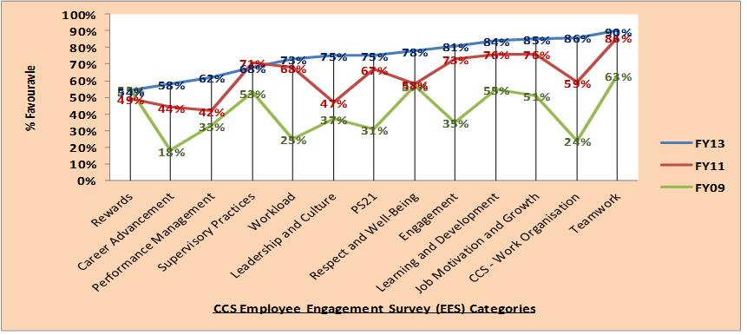
FEEDBACK CHANNELS & MEASUREMENTS
☺
CCS’s EES Survey Categories: All Positive Upwards Trend

Slide 29
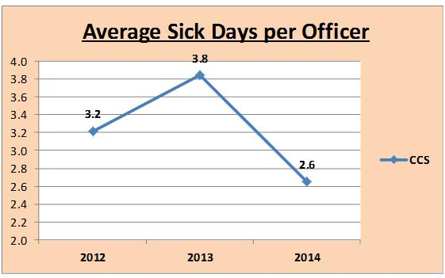
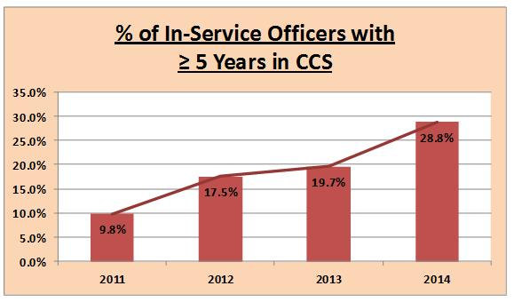
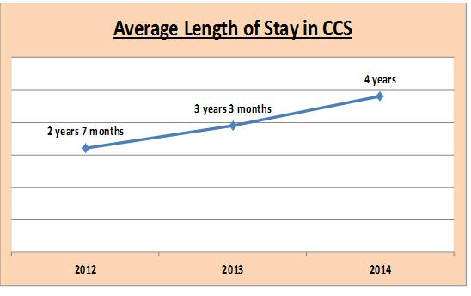
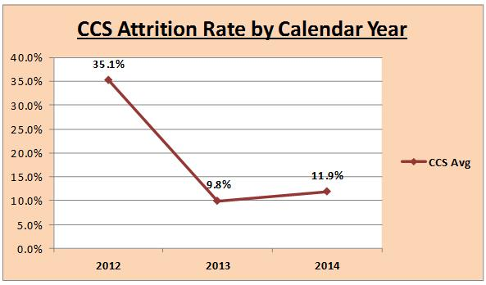
FEEDBACK CHANNELS & MEASUREMENTS
☺
CCS’s Average Sick Days/Pax Lower than PS ☺
More CCS Staff Staying Beyond 5 YIS ☺
CCS’s Average Length of Stay in CCS ☺
CCS’s Attrition Rate: Below Tolerance Level of CCS ☺

Slide 30


www.ccs.gov.sg
Thank you

Slide 31
COMPETITION & CONSUMER
PROTECTION COMMISSION
ICN AGENCY EFFECTIVENESS WORKSHOP, GABORONE, BOTSWANA
REHABILITATION – HEALTH
Beene Shadunka Siyumbwa
10-11th March, 2016

Slide 32
Outline of Presentation
Introduction
Health Committee
Health and other topics discussed
4. Other preventive and support efforts
5. Specialist speakers
6. Effects of having unhealthy staff
7. Benefits of having healthy staff
8. Conclusion
Competition & Consumer Protection Commission

Slide 33
Introduction – Importance of employees to institutions
Engine of any institution – growth and sustainability.
Organisational success depends on employee performance.
Valuable assets.
Employees can make or break an institution.
Their contribution is invaluable.
Competition & Consumer Protection Commission

Slide 34
Introduction
Common diseases in Zambia
HIV/AIDS prevalence rate is about 14% – CSO.
Increase in cancer cases especially cervical cancer.
Malaria: the number 1 killer in children under 5.
Cholera
A lot of TB cases arising mainly from compromised immunity due to HIV/AIDS.
High blood pressure cases, diabetes and heart conditions especially among the affluent (NCDs).
Stress-related conditions such as migraine headaches and depression.
Competition & Consumer Protection Commission

Slide 35
Health Committee
Arising from the various diseases in the community in which we live, a health committee was constituted to:
Deal with all health-related issues that would
have an impact on productivity;
Look at preventive measures and solutions to problems; and
Arrange for health talks on various topics of
interest at least twice a quarter.
Competition & Consumer Protection Commission

Slide 36
Health topics discussed
HIV/AIDS.
Various forms of cancer.
Diabetes and high blood pressure.
Reproductive health.
Good nutrition.
Exercise and fitness.
Depression.
Competition & Consumer Protection Commission

Slide 37
Other topics discussed
Stress management.
Anger management.
Financial management.
Work - family balance.
Drug abuse (Substance Abuse)
Gender-based violence (GBV).
Psychosocial problems.
Competition & Consumer Protection Commission

Slide 38
Other preventive and support efforts
Once a year, we have a health day during which all staff are required to undergo medical check-ups.
During the month of October, female employees go for cervical screening as part of their health awareness.
During the annual institutional team building event, health checks are also conducted for all staff.
Distribution of male and female condoms in restrooms.
Digital BP machine, Thermometer & Weighing scale.
6 trained First-Aiders.
Competition & Consumer Protection Commission

Slide 39
Other preventive and support efforts
For staff living with HIV/AIDS, the Commission provides the supplements recommended by the doctors.
HR embarks on counselling depending on the nature of the problem exhibited.
Where the problem is severe and needs outside attention, the Commission refers staff to professional counsellors from specialised institutions.
Referrals include HIV/AIDS issues, severe depression, psychosocial problems, etc.
Competition & Consumer Protection Commission

Slide 40
Specialist speakers
From University Teaching Hospital – communicable and NCDs.
Private clinics.
Counselling institutions.
HIV/AIDS organizations.
Nutrition Commission.
Mental hospitals to deal with depression and psychosocial problems.
Competition & Consumer Protection Commission

Slide 41
Specialist speakers
Non-government organizations.
Motivational institutions.
Workers Compensation Fund Control Board.
Drug Enforcement Commission (substance abuse).
Victim Support Unit of the Police Service (GBV).
Planned Parenthood Association of Zambia (PPAZ).
Competition & Consumer Protection Commission

Slide 42
Effects of having unhealthy staff
Too many sick notes.
Absence from work.
This leads to low productivity.
Performance output is affected.
Stress affects body, thoughts, feelings and behaviour.
Competition & Consumer Protection Commission

Slide 43
Effects of having unhealthy staff
Stress may lead to high blood pressure, heart disease, obesity, diabetes, stroke, mental and emotional problems.
Financial mismanagement can lead to stress as well – staff can be highly indebted, increased corrupt practices, etc.
GBV – Sexual, physical, emotional and physical abuse This can lead to psycho-social problems.
Competition & Consumer Protection Commission

Slide 44
Benefits of having a healthy staff
Improved work performance and productivity
Reduced absenteeism and sick leave
Reduced health costs
Increased morale, satisfaction and motivation
Contributes to the growth of the Commission
Improved employee engagement and relations.
Enhanced corporate image and attraction and retention of employees
Increased health awareness and knowledge
Competition & Consumer Protection Commission

Slide 45
Benefits of having a healthy staff
Stress-free employees will be free from the stress-related ailments
Employees free from GBV will be physically, emotionally and psychologically healthy.
Employees free of drugs will be rational in their decision-making.
Financially stable employees live within their means and are sober. They are able to make right judgements.
Competition & Consumer Protection Commission

Slide 46
Conclusion
Preventive rehabilitation is critical as we cut down health costs in the long run.
When Commission staff exhibit health ailments, we give immediate attention to dealing with them to ensure that the problems are addressed.
In circumstances where the Commission cannot handle certain problems, we seek professional advice.
A healthy and balanced employee is productive and motivated and contributes to the growth of the Commission.
Competition & Consumer Protection Commission

Slide 47
THANK YOU FOR YOUR ATTENTION
All correspondence should be directed to:
Executive Director, Competition & Consumer Protection Commission (CCPC).
4th floor, Main Post Office Building, P O Box 34919, Lusaka.
Telephone: 222775/222787, Fax: 222789, e-mail: zcomp@ccpc.org.zm
Website: www.ccpc.org.zm; Toll free: 5678, on all networks.
Competition & Consumer Protection Commission

Slide 48
Table talk
What are the biggest obstacles for your agency in recruiting high quality candidates, and how do you overcome these?
What are the most effective methods employed by your agency to ensure retention of staff?
What are the most effective tools to promote a healthy working environment and prevent illness and stress? Are there routines in place to rehabilitate staff in the case of long-term illness?

