Slide 1

ICN Agency Effectiveness workshop
Mr. Mihe Heinrich Gaomab II
Chief Executive Officer
Gaborone, Botswana
10 - 11 March 2016

Slide 2
Introduction
The Namibian Competition Commission was formally established on the 9th December 2009
The early years were formative, involving the setting up of the institution, clarifying procedures and building up the institution
To date, It is a fully-fledged institution with over 30 staff complements
The Commission’s operations and execution is guided by the 5 year strategic plan
First generation : 2009/10 to 2013/14
Second generation: 2014/15 to 2019/20

Slide 3
Organizational structure
Restrictive Business Practices
Mergers and Acquisition
Corporate Services Division
Office of the Chief Executive Officer
Board
Economics and Sector Research

Slide 4
Strategy Evolution – Continuity and Change
  1st Generation Strategy
    Operationalise compliance
    Research and development
    Stakeholder partnering and relationships
    Building and developing organisational capacity and capability to realise mandate
  2nd Generation Strategy
    To ensure effective enforcement of the Competition Act as a contribution to creating competitive markets in line with Vision 2030
    To expand the scope of competition regulation and strengthen the quality thereof
    To enhance competition advocacy towards the fulfilment of sound competition principles and practices
    To conduct action oriented research on competition in support of evidence-based competition regulation and policy
    To develop the Commission as a centre of operational excellence in competition regulation

Slide 5
Overview of the Strategic Planning Framework and Process
Stakeholder Orientation
National Outcomes
Logic Model
Hierarchy of Performance
National Outcomes to which NACC Contribute
Development Impact Achieved
Policy Goals
Mission and Mandate
Impact Indicators
Outcomes Realised
Strategic Goals
Goals
Outcome Indicators
Outputs Delivered
Measurable Objectives
Objectives (Division)
Output Indicators
Activities Implemented
Operational/ Divisional Plans
Operational Plans
Activity Indicators
Inputs Utilised
Activity Plans
Activity Plans
Input Indicators

Slide 6
Strategy Map 2015- 2010
Mission:
To safeguard and promote competition in the Namibian market
Vision:
Fair market competition
Values:
National economic interests comes first Impartiality Consistency Accountability for our role Integrity
Strategic Goals | Outcomes
To ensure effective enforcement of the Competition Act as a contribution to creating competitive markets in line with Vision 2030 To expand the scope of competition regulation and strengthen the quality thereof To enhance competition advocacy towards the fulfilment of sound competition principles and practices To conduct action oriented research on competition in support of evidence-based competition regulation and policy To develop the Commission as a centre of operational excellence in competition regulation | Increased compliance with the provisions of the Competition Act Competition policy developed and submitted to MITSD Draft Competition Bill submitted to MITSD Culture of compliance to the Competition Act established Established a knowledge-base on competition in the Namibian economy Established the Commission as a centre of operational excellence in competition regulation

Slide 7
Monitoring, Evaluation and Reporting
Strategise
Strategise
Implement
Implement
Goals, Objectives, Priorities
Budgets, Plans, Targets
Interpret, Assess, Decide, Adjust
Indicators, Analysis Reports
Adjust
Monitor
Adjust

Slide 8
Monitoring, Evaluation and Reporting

Slide 9
A Note on the Life Cycle of a Competition Agency
According to UNCTAD, a competition agency follows different stages in its life cycle
  Stage I:
    Institutional building: setting up office, recruiting staff, ICT, preparing the budget, etc.
  Stage II:
    Advocacy, sector studies, enquiries and focus on non-complex cases
    Training and knowledge management
  Stage III:
    High profile advocacy strategy to raise awareness of the benefits of competition in the market
  Stage IV:
    Investigation of complex cases
    Hi standards of complex cases and cooperation in enforcement
UNCTAD. (2013). Prioritization and resource allocation as a tool for agency effectiveness. Intergovernmental Group of Experts on Competition Law and Policy Thirteenth Session Geneva, 8–12 July 2013. Retrieved July 23, 2015, from http://unctad.org/meetings/en/SessionalDocuments/ciclpd20_en.pdf.

Slide 10
A Note on the Organisational Life Cycle
According to organisational theorists all organisations pass through predictable stages of growth, and their strategies and structures and activities correspond with the stage of growth
Renewal
Maturity
Growth
Decline
Growth
Early Development
Inception
Time

Slide 11
Current situation
The developmental status of the NaCC lies between Stage II and III
The Commission has seen considerable progress in enforcement, with finalisations of investigations with contraventions, in the glass, agro processing and the health industries.
Considerable number of mergers and acquisitions cases have been handled since establishment (over 350 cases).
A number of market studies has been undertaken in the retail, cement, poultry and the automotive industries.
Stakeholder engagement and advocacy through workshops, media and trade fairs
Since establishment the Commission has been active in the building and development of the organizational capacity
Conclusions of MoUs with sector regulators and the CCSA
Review of the competition Act
Finalization of the Competition Policy
Under the 2015 – 2020 Strategic plan, the Commission has earmarked advocacy as a strategic goal towards the fulfilment of sound competition principles and practices.

Slide 12
Situational Analysis
External
Issues
Opportunities
Threats
Review of the Competition Act
Changes to the act will lead to changes in powers and functions
Important to ensure that competition regime is strengthened
Important to balance international standards against national relevance
Use the review of the Act to strengthen the mandate, powers and function of the Commission
Provide greater clarity on matters of legal uncertainty
Influence the substance of the legal review
Economic policy development and implementation
Changing the structure of the economy (narrow, shallow) Sectoral targeted approach
Infant Industry Protection (IIP)
State-led development in terms of the role of SOEs
Commitments to international and regional economic bodies (SACU, SADC, WTO) and EPAs
Investment Bill (ownership)
Embed competition concerns in the implementation of industrial policy, e.g. in the design of the IIP
Competition policy goals and the competition regime can be undermined in the process of state-led economic development (monopolies)
Increasing public awareness of the role of the Commission
Greater public awareness leads to more complaints by the public, and further to increase in workload
Public also demands greater impact by the Commission
Educate the public on the role of the Commission
Interact with public as a critical stakeholder grouping and develop favourable public sentiment

Slide 13
Situational Analysis
External
Issues
Opportunities
Threats
Overlapping jurisdiction with regulators
Commission need to consult with other regulators in regulated sectors
Need for cooperation to effectively regulate competition in regulated sectors
Already commenced with establishing working relationships the MoA
Address competition concerns in regulated sectors and network industries through close collaboration with other economic regulators

Slide 14
Situational Analysis
Internal
Issues
Strengths
Internship and balanced legal and economics skill set
Weaknesses
Building internal competencies
Require economic analysis and competition law competencies
Initial discussions with University of Namibia on curriculum
Need to develop graduate recruitment programme to develop skills
Focus on skills for middle and senior analysts and legal professionals
Scope and quality of regulatory activities
Policies and frameworks are in place to govern and manage the work
Technical infrastructure to support an increase in workload, while maintaining the quality is required
Basic policy framework established to guide action and decision-taking in the Commission – provides a sound basis for the growth and development of the institution
Operational capacity and platform established
Support from key stakeholders, including Ministry
Climate audit
Technical infrastructure such as case, document, information and knowledge management is yet to be developed (file plan, registry, version control)
Current information, communication and networking capabilities have been outgrown
Culture and climate
Minimum standards of professional behaviours are required
Cohesive culture has to be established
Rewarding climate has to be encourages
Work culture and environment is still in formation phase and not yet developed at a standard according to which an organisation such as the Commission should operate

Slide 15
Situational Analysis
Internal
Issues
Strengths
Monthly Executive Committee meeting
Weaknesses
Responsive decision-making
Decision-making process structured as periodic (quarterly when Commission meets), but need responsive decision-making especially in view of merger timelines
Not always able to respond expeditiously due to the structure of decision-making (periodic)

Slide 16
Situational Analysis
Strengths
Weaknesses
01
02
Framework established to guide action and decision-taking in the Commission – provides a sound basis for the growth and development of the institution
Operational capacity and platform established
Support from key stakeholders, including Ministry
Technical infrastructure such as case, document, information and knowledge management is yet to be developed (file plan, registry, version control)
Current information, communication and networking capabilities have been outgrown
      Need to develop graduate recruitment programme and focus on economic analysts and legal professionals
SWOT
Strengthen the mandate, powers and functions
Provide clarity on matters of legal uncertainty
Embed competition concerns in the implementation of industrial policy
Address competition concerns in regulated sectors and network industries
Decisions taken on quarterly basis
Increase and volume of cases will require more frequent decision making
Opportunities
Threats
03
04

Slide 17
National Competition Policy (NCP)
The development of the National Competition Policy is underway with the draft in place.
The Policy is aimed to provide an overarching framework, to imbue competition policy, legislation and rules within the national development frameworks in order to support our national objectives as articulated in our National Development plans and Vision 2030.
The NCP is underpinned among others, by the following guiding principles namely:
Limiting Anti-competitive Conduct
Third Party Access to and Pricing for ‘Essential Facilities/Services’
Developmental Merger Control
Appropriate framework for cross-border investments and transactions
Price Oversight and Surveillance
Key Markets Investigations
Competitive Neutrality
Reforming regulations and policies that may restrict competition
Aligning State Support Measures with Competition
Harmonisation of Competition, Industrial and Trade policies
Adopting and promoting Sectoral Codes of Conduct
Coordination with sectoral regulators
Regional and international co-operation in the field of competition policy
The Policy is at the Ministerial level and is set to undergo through the parliamentary process for approval

Slide 18
Review of the Competition Act
The Competition Act no. 2 of 2003 is undergoing review.
The purpose of the review is to bring the Act in line with international best practices.
Challenges experienced in enforcement of the current Competition law over the years relates to:
Broad exclusions and exemptions from the Competition Act
Limited cartel detection instruments
Incomplete criteria for assessing abuse of dominance
Broad antitrust exemptions
Incomplete framework for merger analysis
Lack of market inquiries power ect.

Slide 19
Review of the Competition Act cont’d
The new bill is expected to:
increase the scope and powers of enforcement, merger control, market inquiries, amongst others.
Enhance the capacity of the NaCC in terms of cartel detection, legal and economic investigation techniques and case handling.

Slide 20
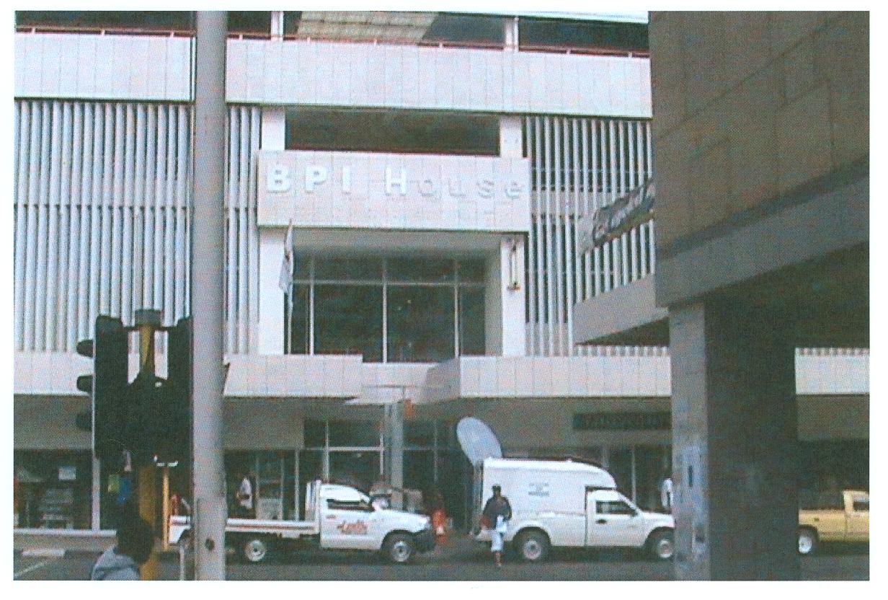
________________________________________________________________
Office Address No 14. BPI House. M Floor. Independence Avenue Tel 224 622 Fax 401 900

