Slide 1


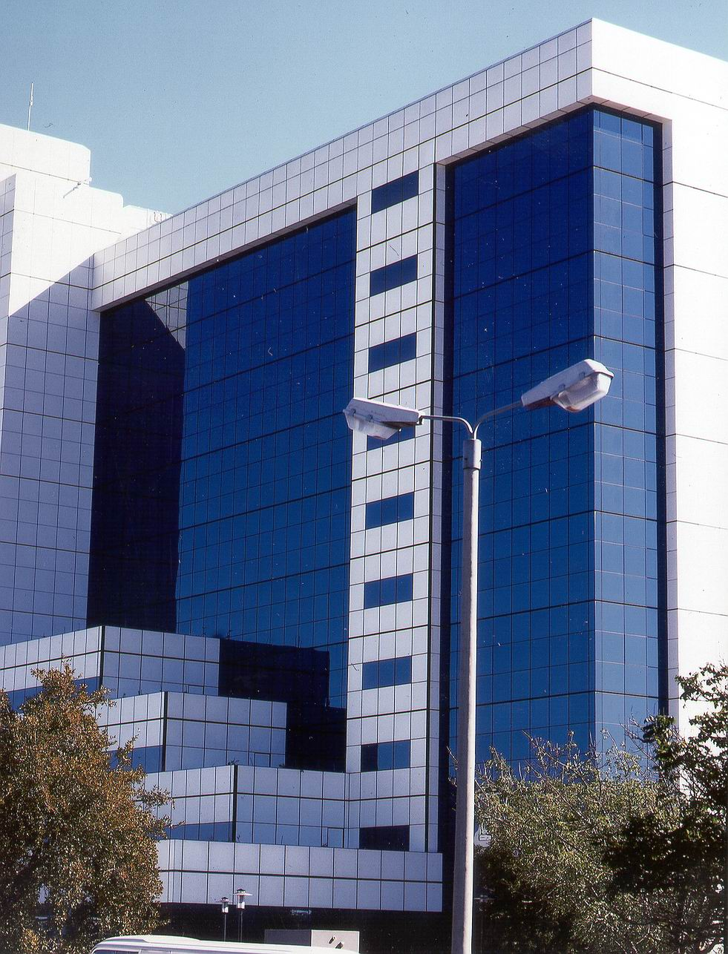
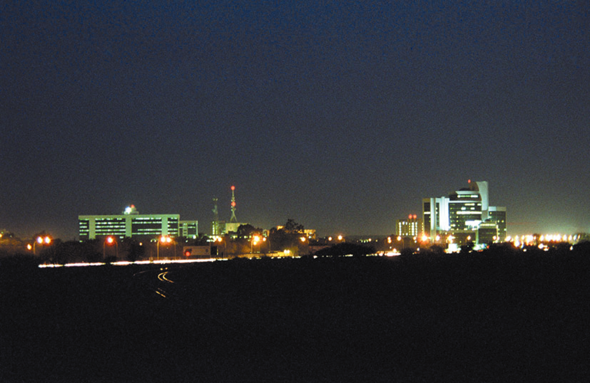
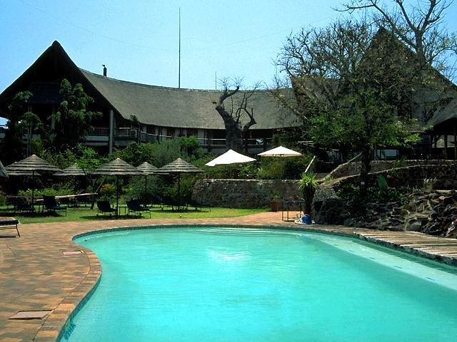
A Place to Invest, Live and Visit
HONOURABLE MINISTER OF INVESTMENT, TRADE & INDUSTRY
Bogolo J. Kenewendo
Thursday 12th July 2018

Slide 2
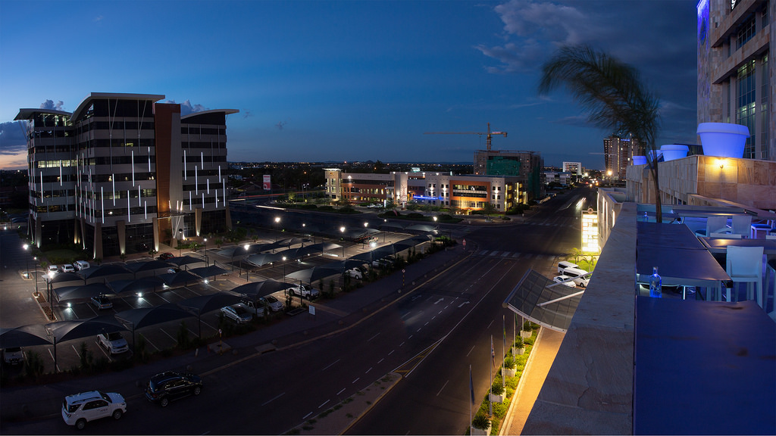
Botswana’s automotive & components sector
A PLACE TO INVEST
Notes:
2

Slide 3
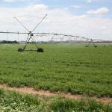
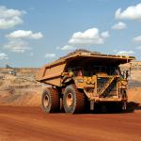
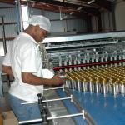
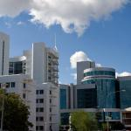
KEY SECTOR OPPORTUNITIES
Commercialization of the agriculture & Agribusiness sector
Mining & Resource Beneficiation
Manufacturing; import bill substitution
Services
Leather
Beef
Primary Production
Agro Processing
Feeds
Ostrich Farming
Soda Ash
Coal
Diamonds
Base Metals
High Import Bill
Automotive Components
General manufacturing; almost all products consumed
ICT & Innovation
Financial & business
BPO
Premised on Accelerating Economic Diversification

Slide 4
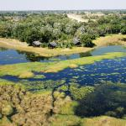

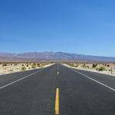
Key Sector Opportunities
Energy
Transport and Logistics
Tourism & Hospitality
Solar
Coal-bed methane (CBM)
Biogas and biodiesel
Coal to Liquids
Hotels & Lodges
Tented Camps
Air Charter Services
Medical Tourism
Rail Projects:
Trans Kalahari Railway
Mosetse – Kazungula
Aviation
Premised on Accelerating Economic Diversification

Slide 5
Trade between Botswana and Switzerland
The SACU-EFTA Agreement signed 2008 to facilitate trade
Switzerland overtook Norway to be the highest export market for Botswana products within the EFTA States
Botswana exports grew from 776 million Pula in 2012 and reached a peak at 2522 million Pula in 2015, in 2017 Value was 1457 million Pula
In 2017 Major Export products; HS 710231 Non Industrial diamonds – P 772 million, unworked and HS 710812 Unwrought Gold – P372 million; HS 710239 Non-industrial diamonds, not mounted or set, nes“ – P 311 million
Imports from Sweden insignificant, comprises goods from HS 85 – electrical machinery and equipment

Slide 6



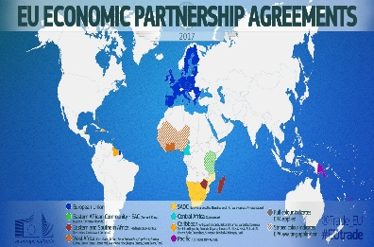

MARKET ACCESS
  Duty free and quota free market access - 61 million consumers (Botswana, South Africa, Namibia, Lesotho and Swaziland)
Preferential market access to more than 293 million consumers in the SADC region
  Duty Free market access within the Non-EU European countries ( Norway, Liechtenstein, Iceland and Switzerland)
Duty free and quota free market access to the European Union
Boosting Intra-Africa Trade (BIAT) which identifies seven priority action clusters: trade policy, trade facilitation, productive capacity, trade related infrastructure, trade finance, trade information, and factor market integration.
Notes:
6

Slide 7
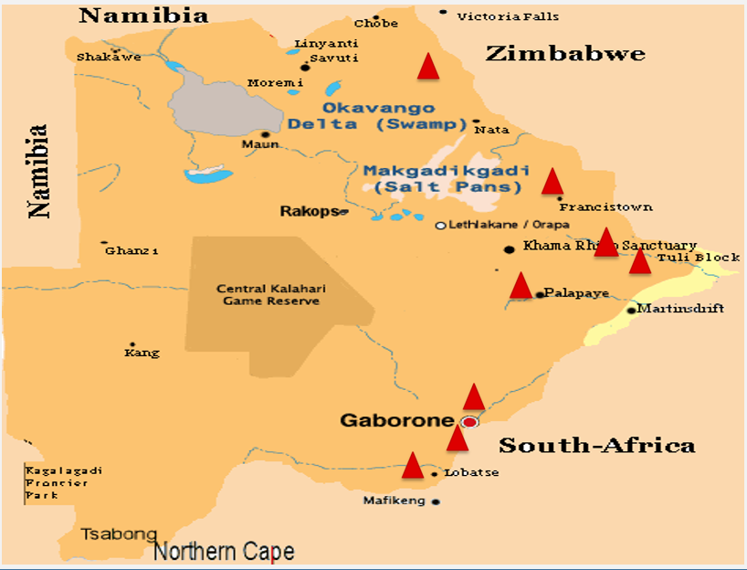
SPECIAL ECONOMIC ZONES
Location of SEZ Sites
Mixed Use SEZ (SSKIA)
International Finance & Tech City (Fairgrounds, Gaborone)
Agropolis (Pandamatenga)
Meat & Leather City (Lobatse)
Mining & Logistics (Francistown)
Base Metal Beneficiation (Selibe Phikwe)
Horticulture (Tuli Block)
Coal & Gas (Palapye)

Slide 8
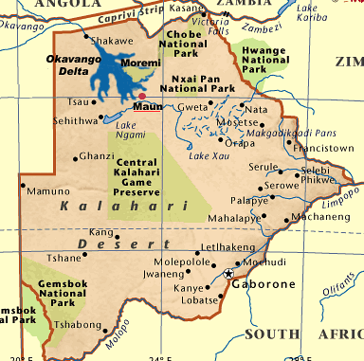
SPEDU INCENTIVES
SPEDU Region has a population of 203 000
SPEDU hub, Selebi Phikwe Town est. in the 70s following discovery and mining and smelting of copper
Government adopted initiatives to spur econ activity in commercial irrigation and Manufacturing
Fiscal
5% for first 5 years; 10% thereafter
Zero customs duty on imported raw material
Provide rebate of Customs duties and Value Added Tax under Schedule 4 - Rebate Item 470.03, and VAT Act Third Schedule - Item 470.03 for manufacturing done exclusively for export outside Common Customs Area (CCA)
Provide rebate of Customs duties and Value Added Tax for importation of raw materials under Schedule 3 of the customs tariff and VAT Act.

Slide 9
SPEDU INCENTIVES
Provision of Land
Minimum 50 year Lease
SPEDU Region will provide internet connectivity with bandwidth that promotes business competitiveness;
Preferential ICT rates (telecommunications, data and voice rates) as already provided for IFSC companies
Input Costs
Direct Government off-take on procurement of at least 30% (First preference in Government procurement provided the quantity, quality and price requirements are met), in line with Economic Diversification Drive (EDD)
Government off-take
SPEDU Region Labour Laws
SPEDU Region Employer - Employee Relations
(To provide work environment which promotes productivity and harmonious employer/ employee relations)

Slide 10
Our Value Proposition
Lowest corporate tax rate in the region (15% for manufacturing /financial services, 22% for all other activities)
Large selection of industrial land & factory space
Trainable workforce and high adult literacy rate
No foreign exchange controls
Duty free importation of machinery used in production
Duty free importation of raw materials used in exportable products
Several double taxation agreements
Good industrial relations
Support to enter regional and international markets for exportable products
Facilitation services through the Botswana One Stop Service Centre (BOSSC)

Slide 11


A PLACE TO LIVE
Modern and attractive to live in, work and enjoy life
Offers good quality of life
A place to raise children and enjoy an excellent work-life balance
Friendly, welcoming and accommodating people

Slide 12

A Place to Visit
A PLACE TO VISIT
Unique and diverse experience
Offers a great tourism experience with a wide range of safari offers, event tourism and adventure.
Home to 2 UNESCO World Heritage Sites; The Tsodilo Hills and the Okavango Delta
Continuously rated as one of the best tourist destinations in the world

Slide 13
INVITATION TO GLOBAL EXPO

Slide 14

Thank You

