Slide 1
  Tools and methods used to evaluate impact
ICN Agency Effectiveness Workshop
11 March 2016
Gaborone, Botswana
Liberty Mncube (Ph.D)
Chief Economist
Competition Commission of South Africa
libertym@compcom.co.za

Slide 2
Our approach

Slide 3
Impact estimation
  For example, consumer savings estimates focusing on direct impact of our work on consumers.
  Estimate impact in the following areas
  Abuse
  Cartels
  Merger control
  Example
  Cement cartel
  Estimated overcharges of between 7.5% & 9.5% & further assumed the cartel would have lasted for another 3 years.
  Consumer savings approx. R4.5 - R5.8 billion.
  The total estimates of consumer savings are conservative in nature.
  General assumptions
  Presenting results in ranges

Slide 4
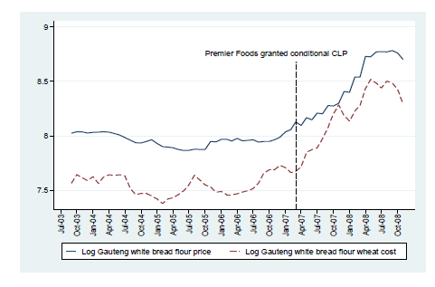
Monitoring
  Not practical to review all cases in-depth
  Conduct ongoing monitoring of competitive dynamics in certain industries to see how these evolve post our actions
  Involves monitoring changes in variables such as prices, output, margins and market shares over time.
  Data Required
  May vary on a case-by-case basis.
    Monthly price data per product
    Monthly cost data
    Monthly volumes sold per product
  Incorporate a reporting requirement into conditions on decisions
  Example
  Telkom settlement has a requirement that the firm will grant the Commission access to its transfer pricing and retail product accounts and underlying documents as may be required by the Commission.

Slide 5
Retrospective studies
Example,
Using information requests, following the cement cartel.
Study found that the break-up of the cartel, was followed by new entry, has generated investment, created jobs, and lower
cement prices.

Slide 6
Research on wider benefits
  Provide links between competition, competition policy and macroeconomic outcomes such as growth, productivity, employment, poverty and inequality
  Research on the effects of competition on poverty and inequality
  WorldBank (2016)
  Estimates the potential gains to the poor from addressing lack of competition in key food markets.
  The study finds that the sanctioning of the cartels helped lower the retail prices of these goods that form a large share of the poor’s consumption basket.
  This lifted the disposable incomes of the poor by 1.6 percent and lowered the national poverty rate by 0.4 percentage points.

