Slide 1
Evaluation of procedures, practices and impact of cases.
No external impact analysis of cases
Efforts focused internally on procedures and practices

Slide 2
Evaluation
Quality and integrity management
Caseload management
Challenges facing the ICA
  An ever increasing case load
  Too many cases lie dormant
  Too many cases are not closed, dismissed or prioritized
  Cases take to long to finish
  Need to focus on important markets and abuse cases

Slide 3
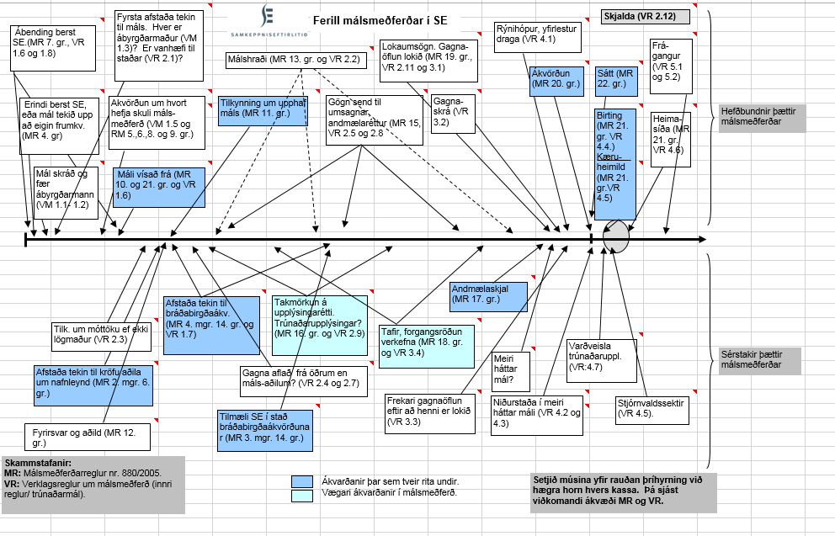
Case - Procedures

Slide 4
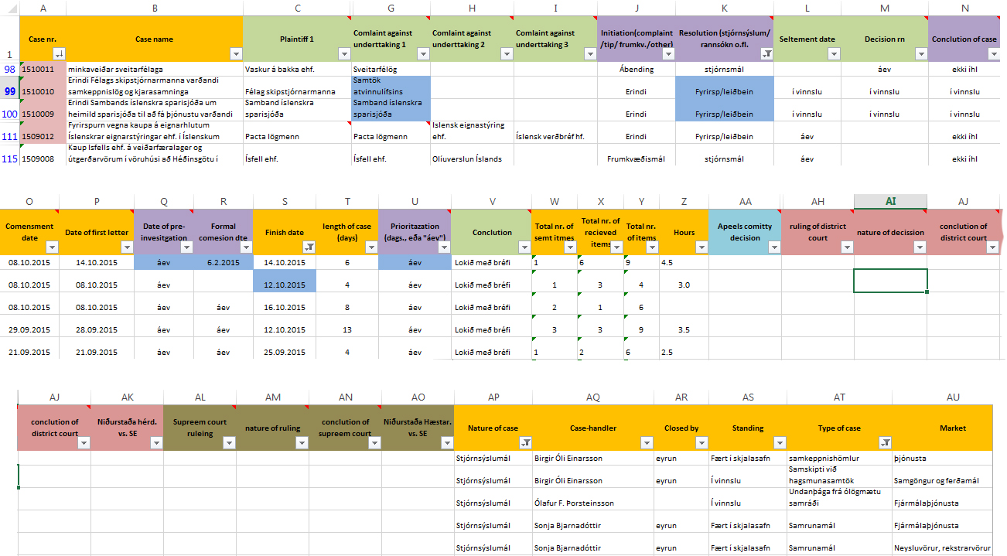
Dataset

Slide 5
Focus on important cases

Slide 6
Average case length

Slide 7
Result
Better utilization for resources
Better time management for case-handlers
Cases finished faster
Integrity of finding in cases better secured due to better procedures.

