Slide 1


The JFTC’s ICN Work Products implementation
11, March 2016
Akira Fujino
Deputy Director, International Affairs Division
Japan Fair Trade Commission

Slide 2
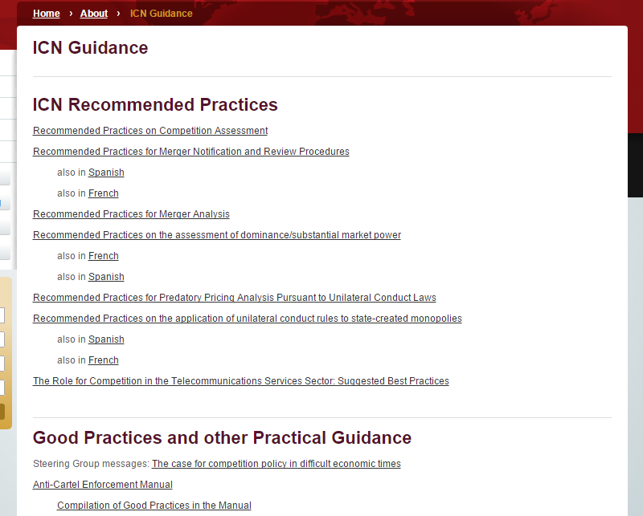
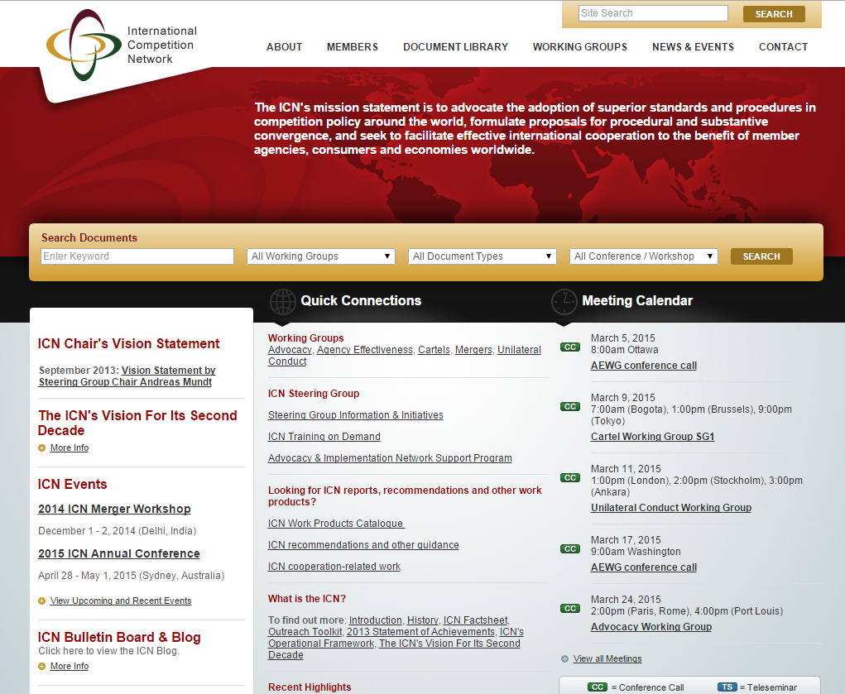
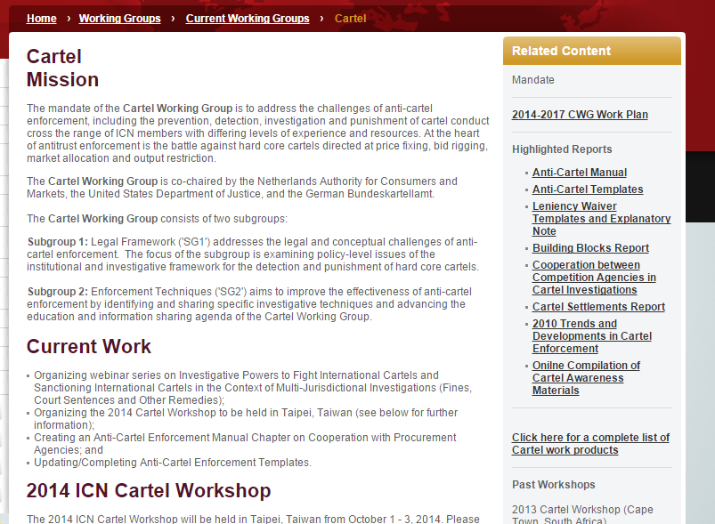
The characteristics of
ICN work products
ICN products have a lot of merits such as…
Wide variety of products
Ease of access
Persuasive power
One stop service function
2

Slide 3
The JFTC uses
the ICN work products for... (1/4)
Amendment of the Law
The amendment of the Antimonopoly Act, competition law of Japan, took into effect in 2010, which included the revision of merger notification thresholds to make them more consistent with the Recommended Practices for Merger Notification & Review Procedures. After the amendment, the notification thresholds shall be based on the total amount of domestic turnover of a corporate group to ensure local nexus to the jurisdiction.
Discussion on reviewing investigative practices
The JFTC also uses the ICN work products for the Case Investigation, especially “Compilation of Good Practices from the Anti-Cartel Enforcement Manual” in order to check and review the current cartel investigative practices such as dawn raids.
For example, in initiating the dawn raids, we have the investigators present their identification cards as investigators and notify the alleged facts in writing. We conduct interviews of the employees of the alleged violators during and soon after the dawn raids. For international cartels such as the Marine Hose Bid-rigging case, we coordinated the schedule for simultaneous raids with other competition authorities and share the information to the utmost extent permitted under the existing legislation. These practices are picked up as Search Team Composition, Planning Presentation of Warrant, Taking Statements during the Search, and Coordination with other agencies in the “Compilation of Good Practices from the Anti-Cartel Enforcement Manual”.
3

Slide 4
The JFTC uses
the ICN work products for... (2/4)
Checking and reviewing the current cartel investigative process
As the supplementary clause of amended Antimonopoly Act sought the review of investigation procedure, the Cabinet Office of Japan held the Advisory Panel to review investigative procedures of the JFTC in 2014. At that time, we used the Survey Report on Enforcement Tools of the Agency Effectiveness Working Group, and Cartel Settlements of the Cartel Working Group and so on, to identify and explain the current situation of the competition regimes across the world regarding the issues such as legal privileges and investigative powers, etc. As a result, the Advisory Panel of the Cabinet Office issued the Report concerning investigative procedure of Antimonopoly Act. Taking into account of the Report, the JFTC published the Guidelines on Administrative Investigation Procedures under the Antimonopoly Act 25 December 2015.
International cooperation
(ICN Framework for merger review cooperation)
The JFTC used the Framework for Merger Review Cooperation in cross border transactions, such as, ASML/Cymer, Zimmer/Biomet, TEL/AMAT and the like. The JFTC cooperated with various jurisdictions, such as, USFTC, USDOJ, EC, KFTC, and TFTC to exchange information about schedule, market definition, and remedies.
4

Slide 5
The JFTC uses
the ICN work products for... (3/4)
Technical assistance activities for younger agencies
The JFTC implemented the training course for Vietnam under the framework of AISUP from 2009 to 2011. During the training course, we greatly used “Compilation of Good Practices from the Anti-Cartel Enforcement Manual” and Chapter 1, Searches, Raids and Inspections, Chapter 3, Digital Evidence Gathering, Chapter 4, Cartel Case Initiation, and Chapter 5, Investigative Strategy, of the Anti-Cartel Enforcement Manual in delivering the JFTC’s own practices. Through using the ICN work products coupled with our own practices and experiences, we could share common knowledge and know-how more efficiently and effectively.
The JFTC provides the training course for developing countries on competition law and policy, collaborating with Japan International Cooperation Agency (JICA) every year. In the training course, we refer to or introduce Anti-Cartel Enforcement Manual for staff from younger agencies in addition to the introduction to the ICN and its work products.
In-house training
We use some Merger Working Group work products as the training materials for merger review case handlers.
5

Slide 6
The JFTC uses
the ICN work products for... (4/4)
Report by the Competition Policy Research Center of the JFTC
The Competition Policy Research Center (CPRC) of the JFTC is conducting collaborative research in a team of the JFTC staff and the visiting economists and jurists. CPRC used some ICN work products for reference in creating CPRC reports such as “Competition Policy in Network Industries – Comparative Legal Studies across Japan, USA and EU and Economic Analysis” and “Reports on Behavioral Remedies in Merger control in other countries”.
Others
When we create or revise laws, regulations, guidelines and survey reports, we often research other jurisdictions’ legal frameworks and enforcement of their laws and regulations in general. When doing the above work, the ICN work products plays a beneficial role. We refer to ICN work products to examine how our legal framework is compatible with other jurisdictions’.
6

Slide 7


Thank you
very much for your attention!

